Slide 1
Predicting Federal Funds Rate
NYU Machine Learning in Financial Engineering
Joohi Rana, Han Yan, Amy Ge

Slide 2

Federal Funds Rate
Target interest rate range set by the Federal Open Market Committee (FOMC)
Set eight times a year
12 FOMC members vote on the rate decision
Influenced by economic indicators, such as the core inflation rate and the durable goods orders report, and job reports
There was a series of 11 consecutive rate hikes, 4 of which were this year
Last 2 decisions were to hold rates
Current rate is at 5.25-5.5%
Notes:
provide signals about the economic health of the country

Slide 3
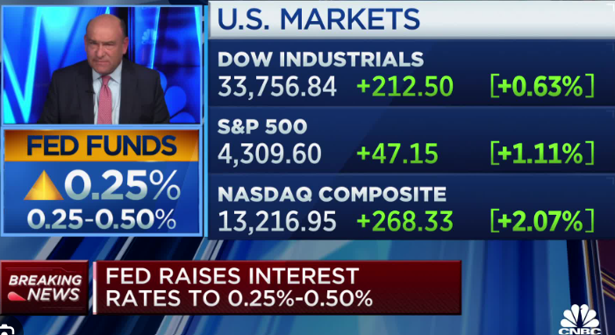
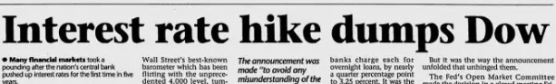
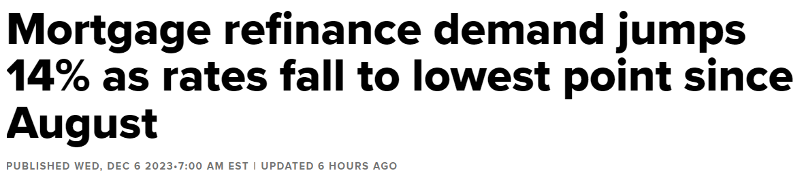
Importance
It sets all other rates such as loans rates, credit card rates, and mortgages
Impacts the stock market
“Don’t fight the Fed”
Buy stocks during rate cuts
Sell stocks during rate hikes
Housing markets
30y mortgage at 7% vs 5% early in the year, peak at 8%
Discourages buying houses
Notes:
For example, a small decline in the rate can prompt the market to leap higher as the borrowing costs for companies get lower. Many stock analysts pay particular attention to statements by members of the FOMC to try to get a sense of where the target rate may be headed. "Don't fight the Fed" is an old investor saying that cautions you to align your investments with the current monetary policies of the Fed

Slide 4

Problem
Using economic indicators, predict if the FOMC will raise, hold, cut rates in the next meeting to help make better financial decisions

Slide 5
Dataset
Original data, from St. Louis Fed website, was till 1954, FOMC statements till 1994 to Sept 2023, total 357 records used
Features:
PCE - Personal Consumption Expenditures - a measure of the prices that Americans pay for goods and services Excluding Food/Energy
Consumer_Sentiment - Consumer Opinion Surveys: Confidence Indicator
Supply_NewHouse - months' supply is the ratio of new houses for sale to new houses sold
CPI - Consumer Price Index for All Urban Consumers
ISM PMI - purchasing managers' index (PMI), is a monthly indicator of U.S. economic activity based on a survey of purchasing managers at more than 300 manufacturing firms
Housing_starts - New Privately-Owned Housing units in Thousands
Unemp_rates - Unemployment Rate, Percent, Monthly, Seasonally Adjusted
SPX - monthly average S&P 500 index value
10y_try - monthly average 10 year US Treasury Yield
sentiment_score_LM - shows the sentiment score generated by counting sentimental words in Loughran and McDonald word list
Sentiment - Positive / Negative / Neutral)
Target:
-1 - decrease (33%)
0 - hold (18%)
1 - increase (49%)
Notes:
PCE - a measure of the prices that people living in the United States, or those buying on their behalf, pay for goods and services
The ISM manufacturing index, also known as the purchasing managers' index (PMI), is a monthly indicator of U.S. economic activity based on a survey of purchasing managers at more than 300 manufacturing firms. It is considered to be a key indicator of the state of the U.S. economy.

Slide 6
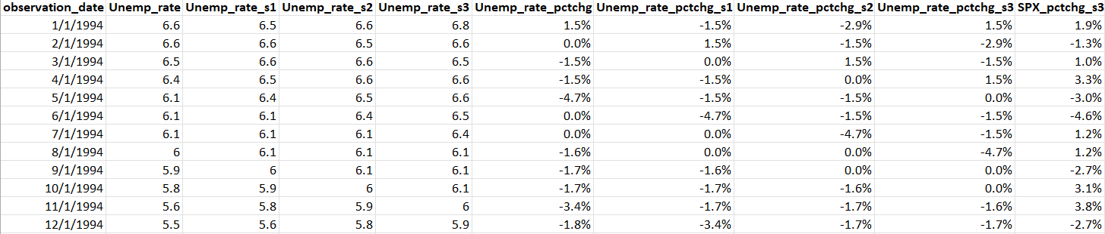
Feature Engineering
Calculated percent changes
Created Shifts to get prior months

Slide 7
Feature Engineering - Sentiment features
Scrapes FOMC statements that are released the same day when the rate is decided
The sentiment (Positive / Negative / Neutral) generated by a pre-trained BERT model on financial news (from hugging face)
Sentiment_score_LM: shows the sentiment score generated by counting sentimental words in Loughran and McDonald word list
(number of positive words - number of negative words） / total word count of statement
Notes:
https://huggingface.co/ahmedrachid/FinancialBERT-Sentiment-Analysis?text=Operating+profit+rose+to+EUR+13.1+mn+from+EUR+8.7+mn+in+the+corresponding+period+in+2007+representing+7.7+%25+of+net+sales.

Slide 8
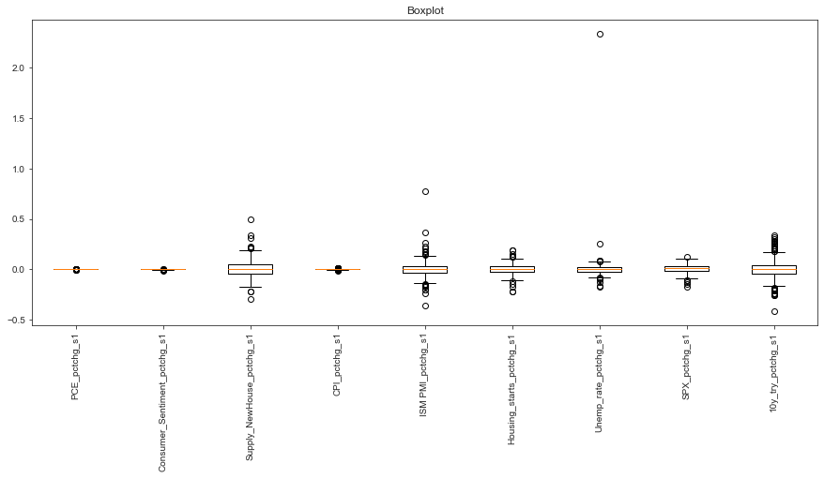
Exploratory Data Analysis
Unemployment Rate percent change from 1 month
250% increase from 4% to 15% unemployment rate on May 5/1/2020
Removed point

Slide 9
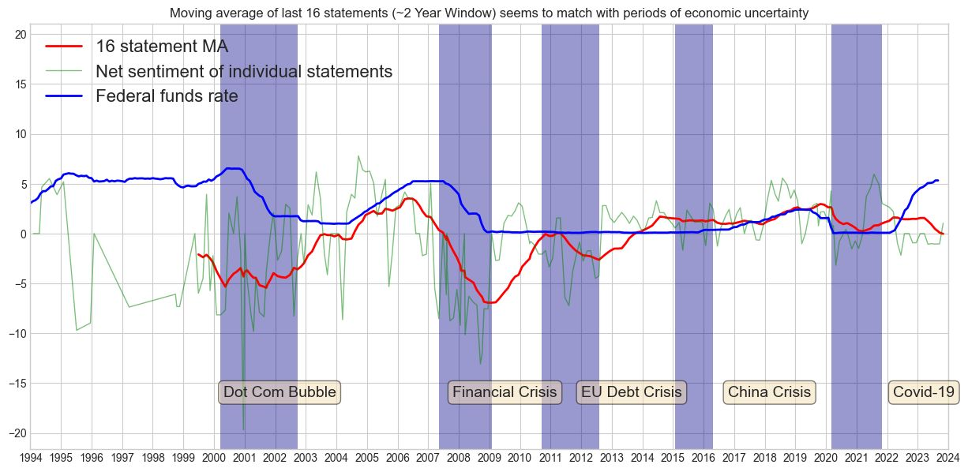
Exploratory Data Analysis

Slide 10
Feature Selection - PCA and Lasso
20 out of 84 features are selected for modeling
Promising features (considering Lasso results):
'ISM PMI'
'PCE_pctchg'
'ISM PMI_pctchg_s1'
'Unemp_rate'
'Unemp_rate_s3'
'Unemp_rate_pctchg_s3'
'10y_try_s1'
'10y_try_pctchg_s1'
'10y_try_pctchg_s2'
'Housing_starts_pctchg'
'Housing_starts_s3'
'Consumer_Sentiment_pctchg'
'Consumer_Sentiment_pctchg_s1'
'CPI_pctchg’
'SPX_pctchg'
'sentiment_score_LM_s1'
'Sentiment_s1'
'Sentiment_s2'
'Sentiment_s3'
'sentiment_score_LM_s3'

Slide 11
Data Processing: Obstacles
Missing Data
Imbalance Data
Overfitting
Sentiment missing
Eight rate decisions per year caused missing sentiments for some months. Forward filling is used.
Oversampling
Target ‘hold’ is significantly less than ‘increase’ or ‘decrease’. SMOTE is used to oversample minority class on train set in the baseline model. But we decided not to use SMOTE as it is not appropriate for time series
Increase conversion
Splitting by time caused training set accuracy was higher than test set
We used rolling window as training

Slide 12
Building Model

Slide 13
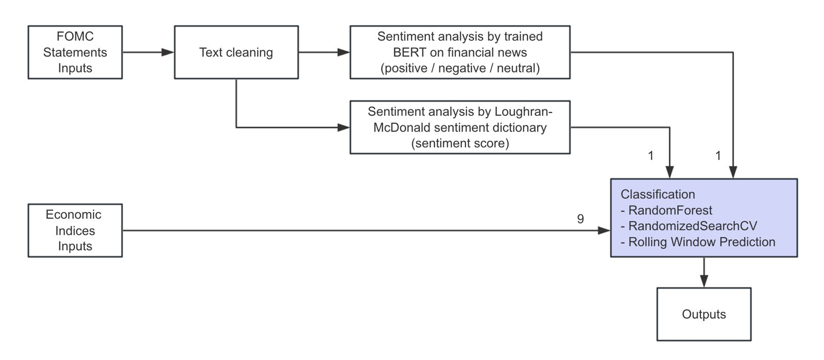
Model
We used Random Forest
Split the data by time (Baseline model) and rolling windows
Initial Train set -
1994 to 2017 (78%)
Test set - rolling
Hyperparameter Tuning
5 split cross validation
Notes:
n_estimators Number of trees in random forest
max_features # Number of features to consider at every split
Max_depth # Maximum number of levels in tree
Min_samples_split Minimum number of samples required to split a node
min_samples_leaf # Minimum number of samples required at each leaf node
bootstrap # Method of selecting samples for training each tree
class_weight = # Class weight

Slide 14
Evaluation Metrics
Recall is important in this project because we always want to be right
Greater cost incurred if model predicts wrong
Example: Model predicts rates will decrease, leading portfolio managers to buy but in reality Fed hike rates causing a bear market
 | Baseline | Rolling Window
 | Test | Test
Accuracy | 43% | 61%
F1 score | 41% | 59%
Precision | 40% | 59%
Recall | 43% | 61%

Slide 15
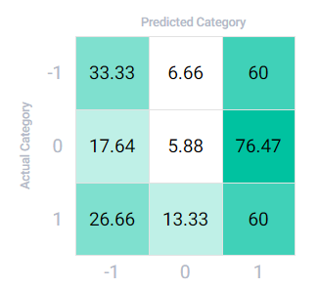
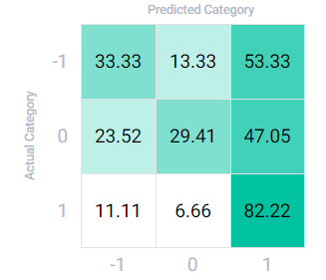
Confusion matrix
Baseline
Rolling window
Target:
-1 - decrease
0 - hold
1 - increase
Notes:
Percentages by row totals

Slide 16
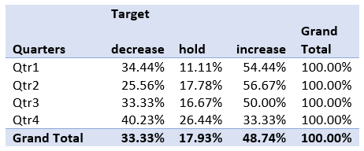
Recall by Quarters
 | Recall
Qtr1 | 61%
Qtr2 | 60%
Qtr3 | 66%
Qtr4 | 56%

Slide 17
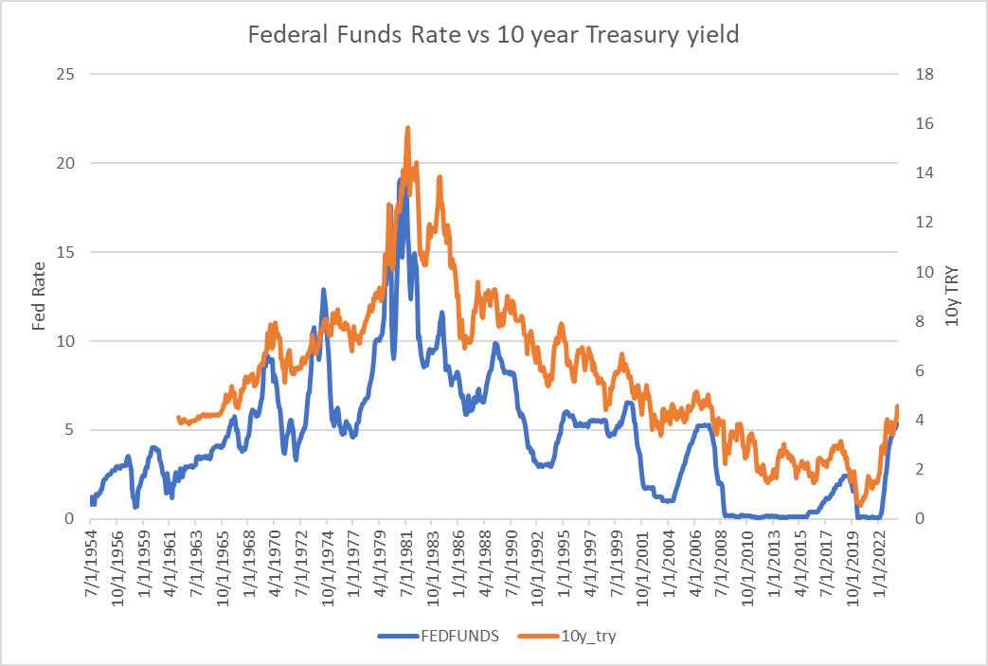
Best features
Rolling Model
10y_TRY_s1 | 0.101
ISM_PMI | 0.089
sentiment_score_LM_s3 | 0.079
Housing_starts_s3 | 0.078
PCE_pctchg | 0.063
Unemp_rate_pctchg_s3 | 0.054
Housing_starts_pctchg | 0.052
Unemp_rate | 0.048
Consumer_Sentiment_pctchg_s1 | 0.046

Slide 18

Future Steps
Scrape more textual data
FOMC minutes
News reports
Conferences
Include more economic features like GDP, durable goods report

Slide 19
Let’s check out the app!

Slide 20
Appendix

Slide 21
Federal Funds Rate
What?
When?
Why?
target interest rate range set by the Federal Open Market Committee (FOMC)
Current rate is at 5.25-5.5%
The Federal Open Market Committee (FOMC) meets eight times a year to determine the federal funds target rate.
It sets all other rates such as loans rates, credit card rates, and mortgages

Slide 22
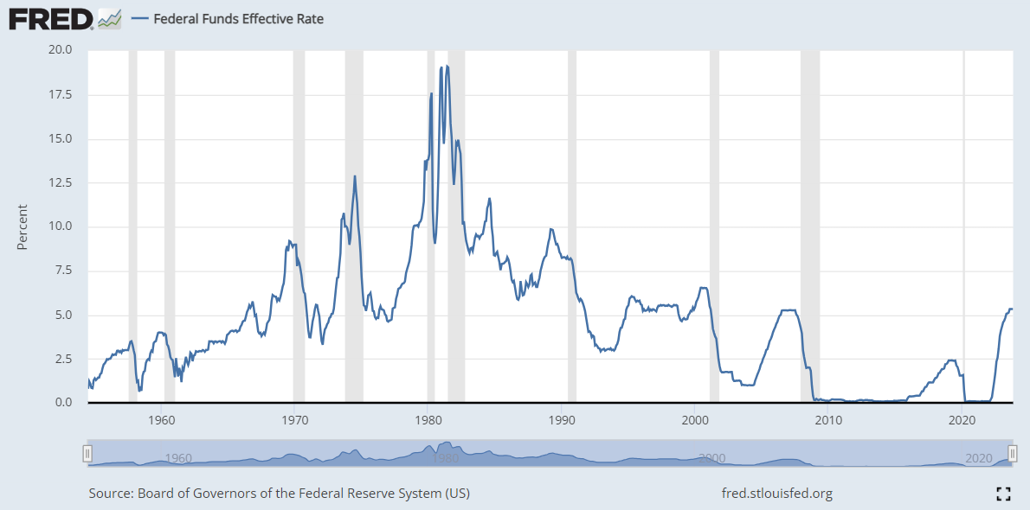
Federal Funds Rate
Target interest rate range set by the Federal Open Market Committee (FOMC)
Set eight times a year
It sets all other rates such as loans rates, credit card rates, and mortgages
Current rate is at 5.25-5.5%

Slide 23
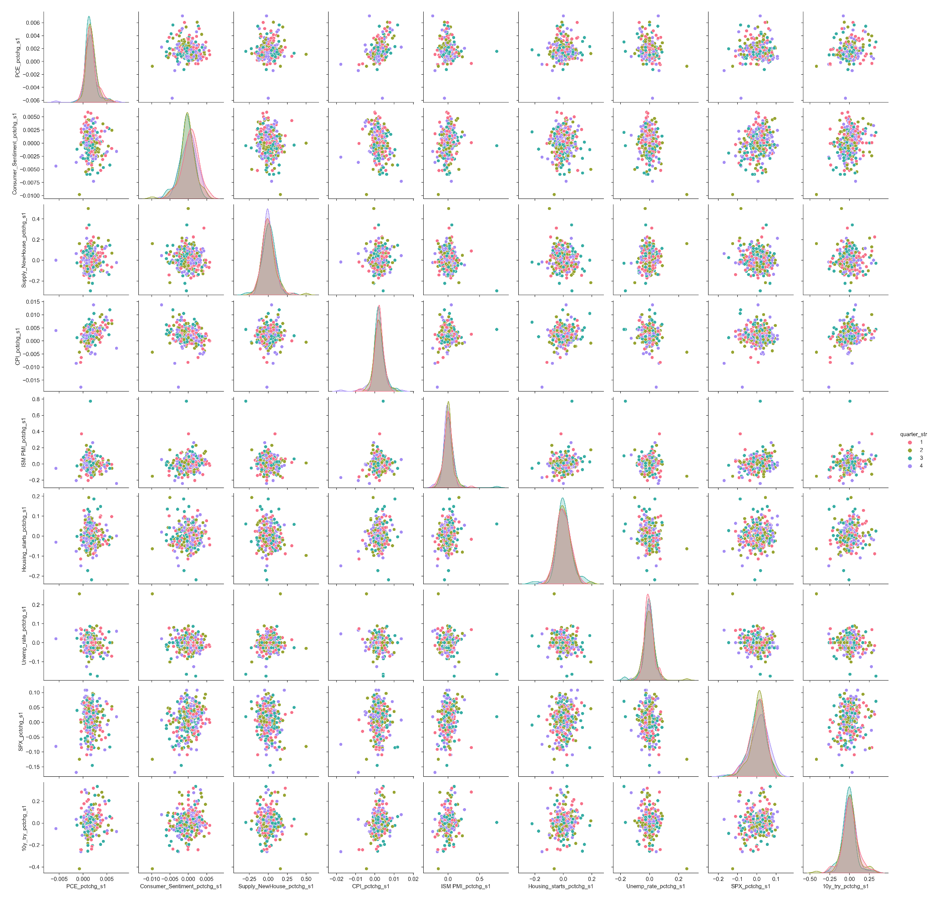
Exploratory Data Analysis
Pair plot after removing the extreme value of Unemp_rate_pctchg_s1
Data points classified by quarter of the year
Approximately normally distributed

Slide 24
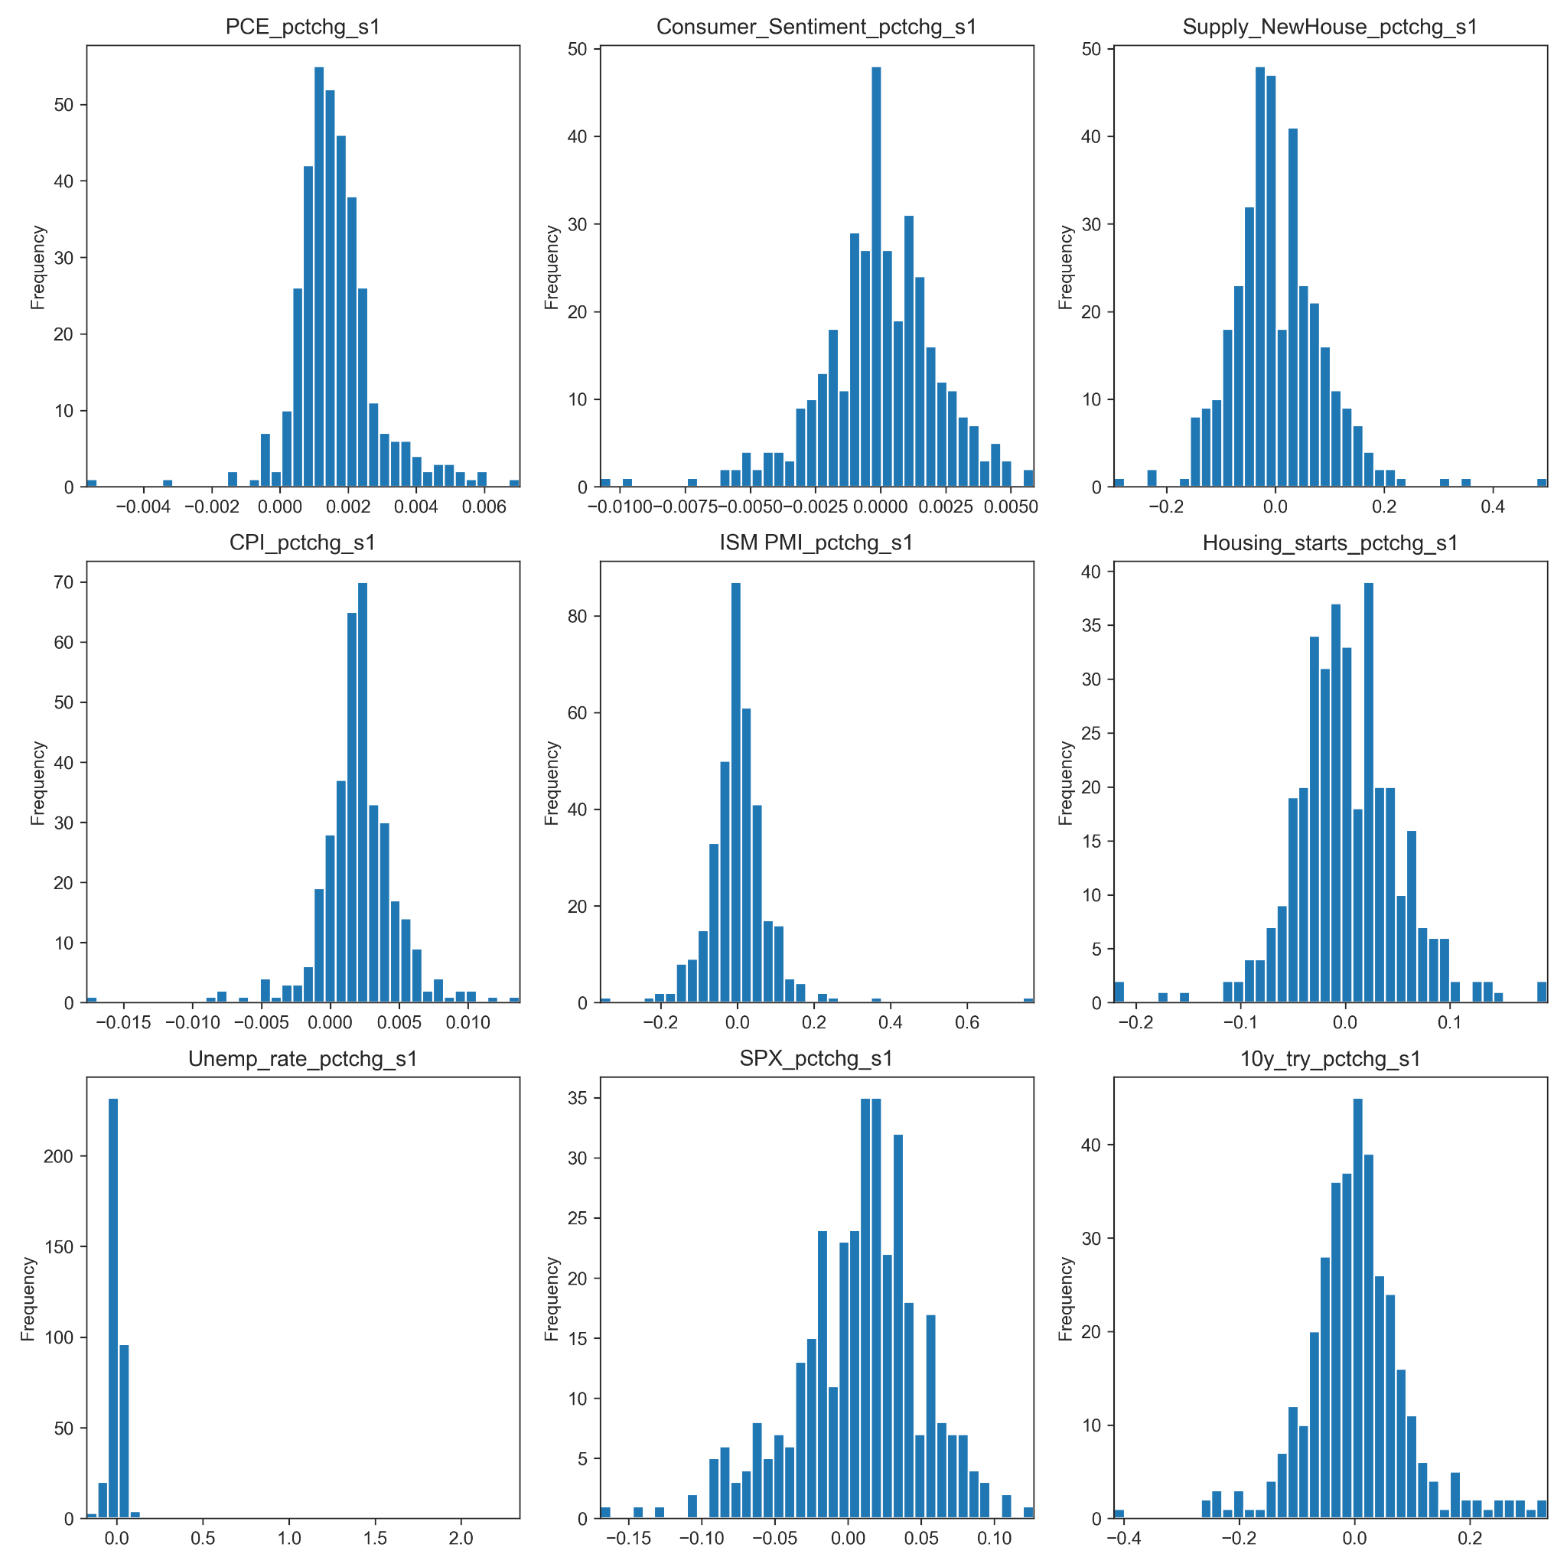
Exploratory Data Analysis
Normally distributed data points
Notes:
Histogram of our main features - all normally distributed

Slide 25
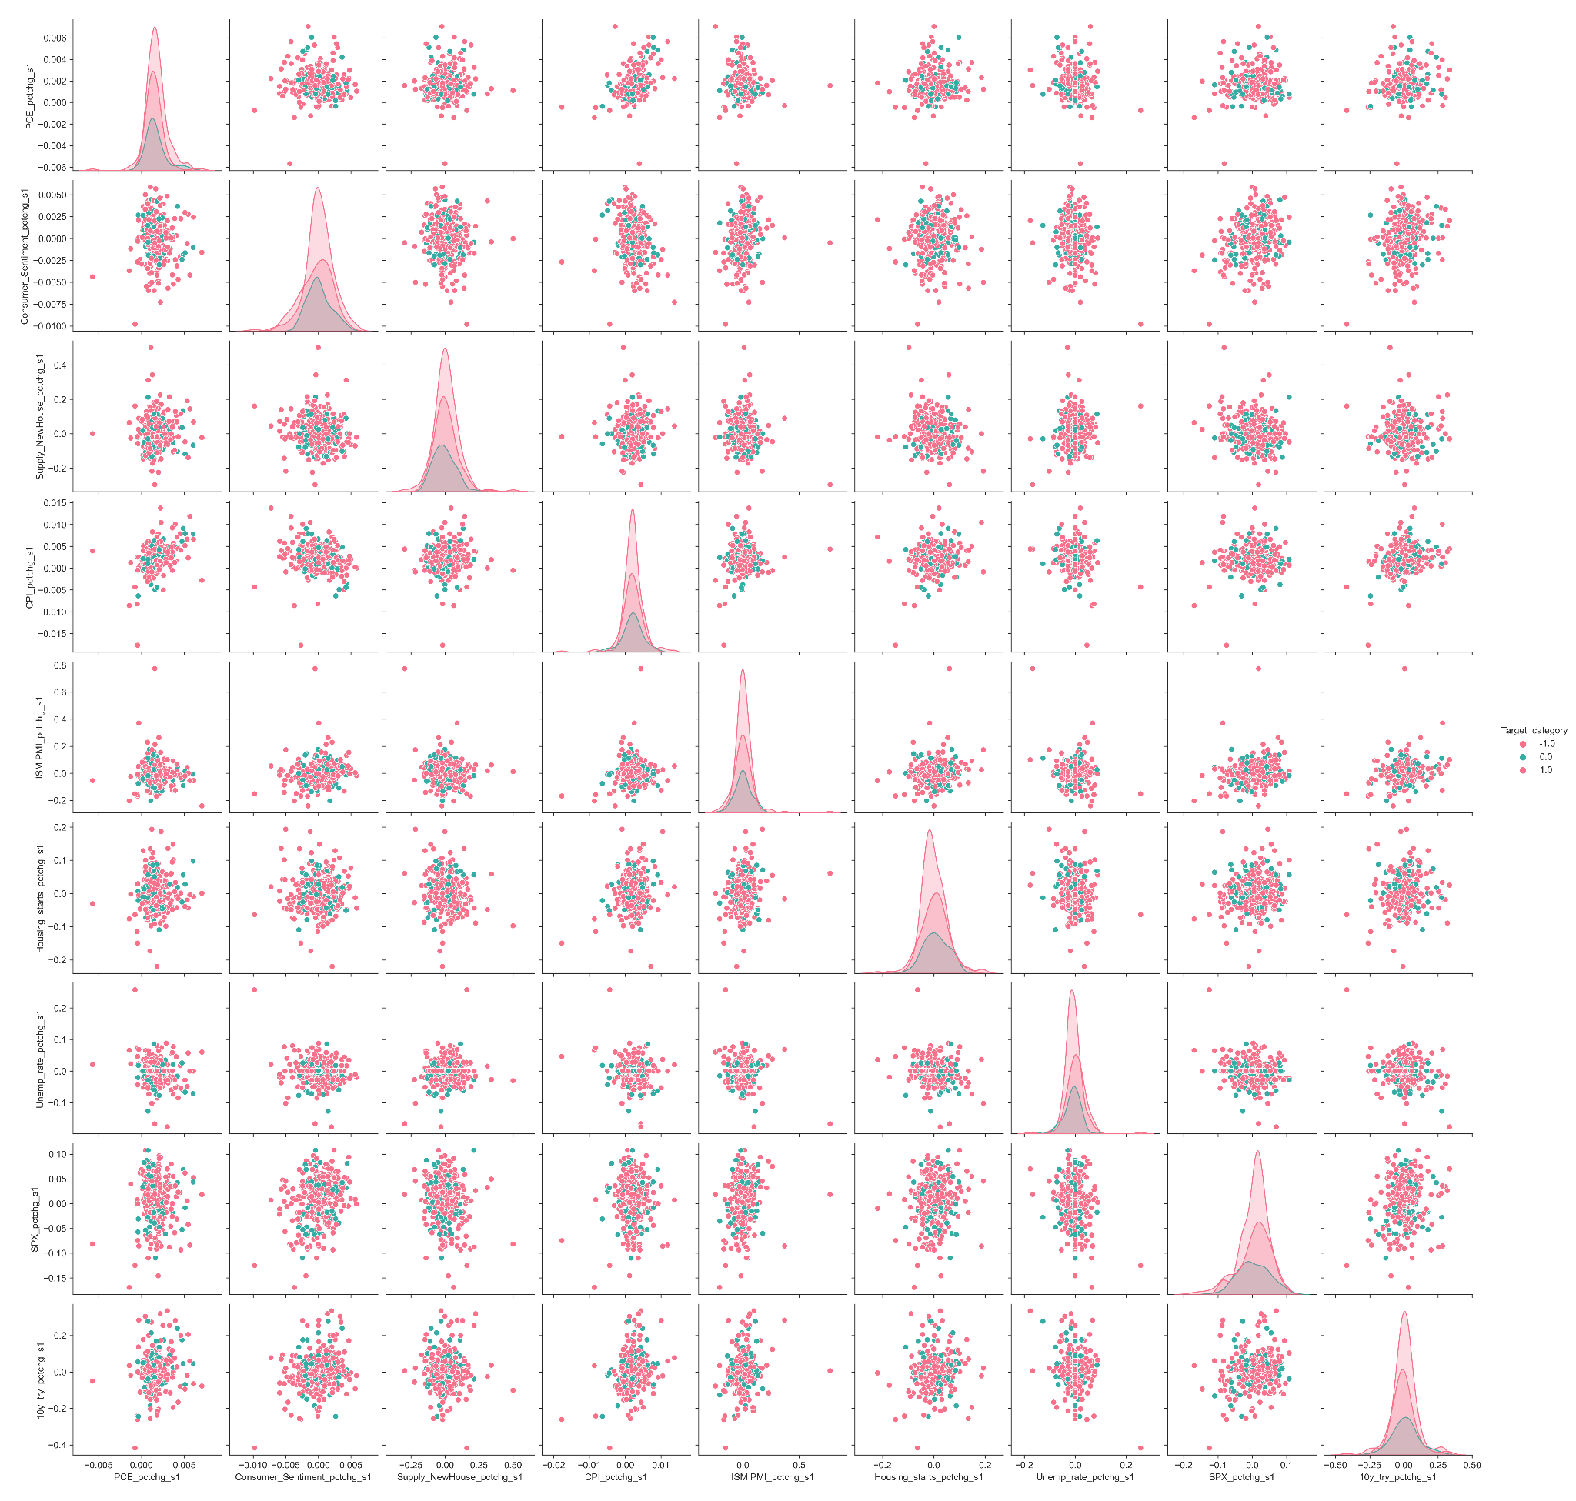
Exploratory Data Analysis
Pair plot after removing the extreme value of Unemp_rate_pctchg_s1
Data points classified by quarter of the year
Approximately normally distributed
‘Increase’ 48.7%, ‘decrease’ 33.3%, hold ‘18%’
Imbalanced categories

Slide 26
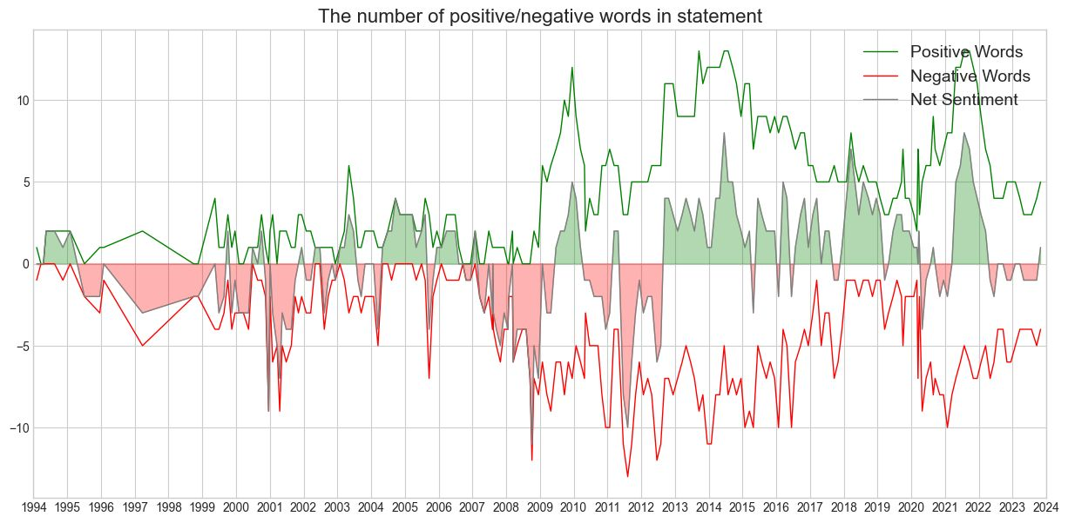
Net Sentiment

Slide 27
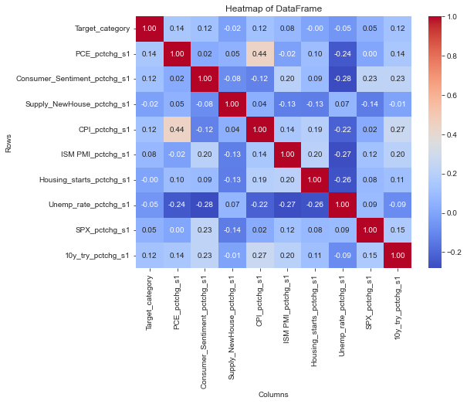
Exploratory Data Analysis
PCE_pctchg_s1 is positively correlated with CPI_pctchg_s1 at 0.44
Target_category positively correlated to
PCE_pctchg_s1,
Consumer_Sentiment_pctchg_s1,
CPI_pctchg_s1,
10y_try_pctchg_s1

Slide 28
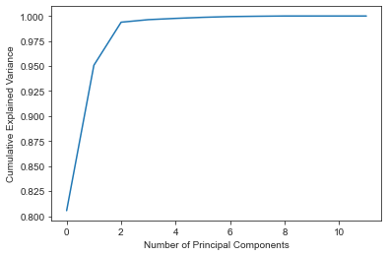
Feature Selection - PCA
Top features for PC1:
'sentiment_score_LM_s1' = 0.81
'Sentiment_s1' = 0.15
'sentiment_score_LM_pctchg_s1' = 0.04
'Unemp_rate_pctchg_s1' = 0.0025
'10y_try_pctchg_s1' = 0.0013 'Housing_starts_pctchg_s1' = 0.001
'Supply_NewHouse_pctchg_s1', 'SPX_pctchg_s1',
'ISM PMI_pctchg_s1',
'CPI_pctchg_s1', 'Consumer_Sentiment_pctchg_s1', 'PCE_pctchg_s1'
Notes:
Princ comp - 1994 - weights showing variance in our target

